Slide 1
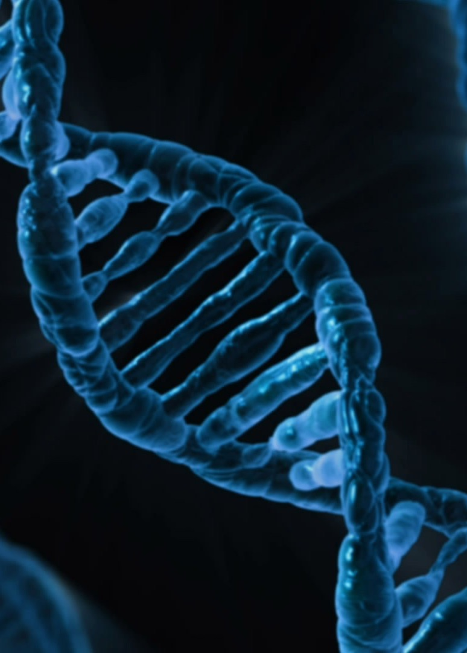
Introduction to Bioinformatics
Cambridge Makerere Summer School 2025
Ashley D Sawle

Slide 2
Overview
A Brief Overview of Bioinformatics
Bioinformatic Analysis of Next Generation Sequencing Data

Slide 3
Overview
A Brief Overview of Bioinformatics
Bioinformatic Analysis of Next Generation Sequencing Data

Slide 4
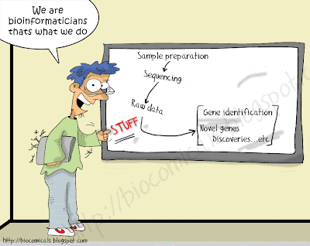
What is Bioinformatics?

Slide 5
What is Bioinformatics?
Bioinformatics is a relatively new and evolving discipline that combines skills and technologies from computer science and biology to help us better understand and interpret biological data.
Bioinformatics, as related to genetics and genomics, is a scientific subdiscipline that involves using computer technology to collect, store, analyze and disseminate biological data and information
The mathematical, statistical and computing methods that aim to solve biological problems using DNA and amino acid sequences and related information.

Slide 6
What is Bioinformatics?
Bioinformatics is a relatively new and evolving discipline that combines skills and technologies from computer science and biology to help us better understand and interpret biological data.
Bioinformatics, as related to genetics and genomics, is a scientific subdiscipline that involves using computer technology to collect, store, analyze and disseminate biological data and information
The mathematical, statistical and computing methods that aim to solve biological problems using DNA and amino acid sequences and related information.

Slide 7

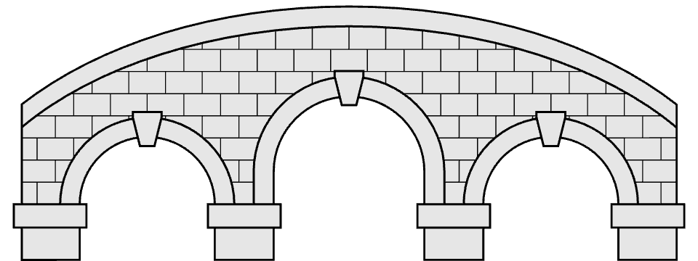
What is Bioinformatics?
Bioinformatics is an interdisciplinary field of science that develops methods and software tools for understanding biological data, especially when the data sets are large and complex.
Bioinformatics
Computer Science
Biology
Statistics

Slide 8
It all started with proteins
1951 – Frederick Sanger sequenced the amino acid structure of insulin
Notes:
COMPROTEIN – protein primary structure – invented the one-letter amino acid code
65 proteins in the APSS
Saul B. Needleman and Christian D. Wunsch

Slide 9
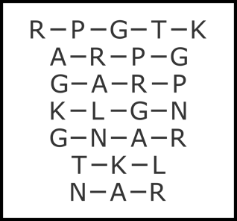
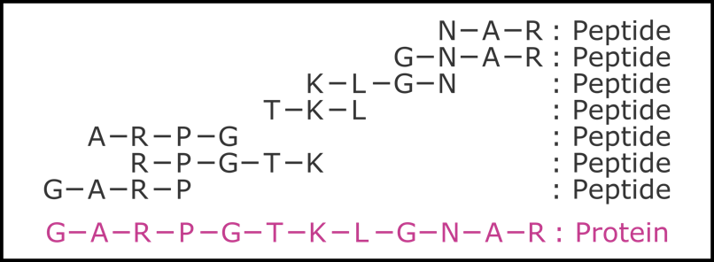
It all started with proteins
Notes:
COMPROTEIN – protein primary structure – invented the one-letter amino acid code
65 proteins in the APSS
Saul B. Needleman and Christian D. Wunsch

Slide 10
It all started with proteins …
1951 – Frederick Sanger sequenced the amino acid structure of insulin
1962 – Margaret Dayhoff and Robert Ledley publish COMPROTEIN
1965 – Margaret Dayhoff published the book “Atlas of Protein Sequence and Structure”
1970 – Needleman-Wunsch algorithm for sequence alignment published
1970s - Peter Chou and Gerald Fasman develop first protein structure prediction algorithm
1971 – The Protein Data Bank
Notes:
COMPROTEIN – protein primary structure – invented the one-letter amino acid code
65 proteins in the APSS
Saul B. Needleman and Christian D. Wunsch

Slide 11
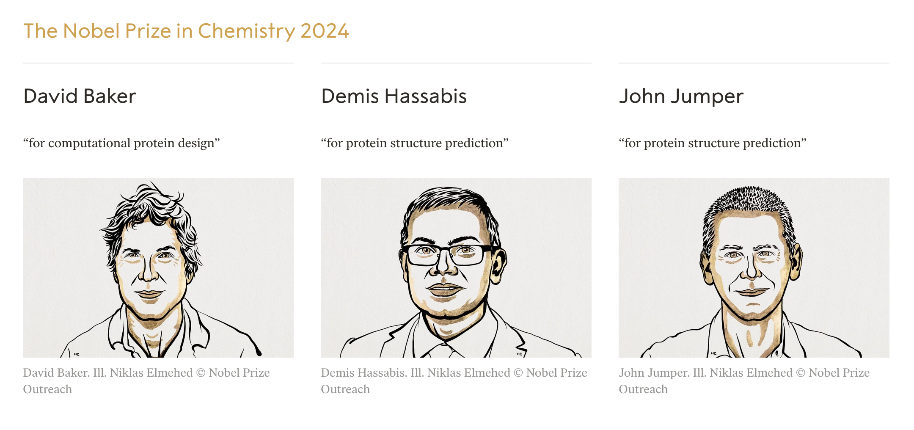
… and it continues with proteins

Slide 12
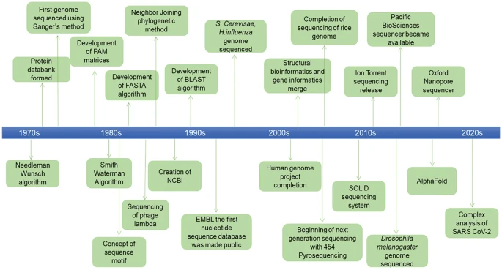
A history of nucleotide sequencing

Slide 13
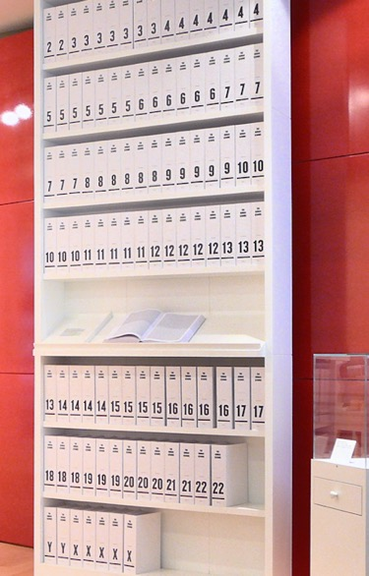
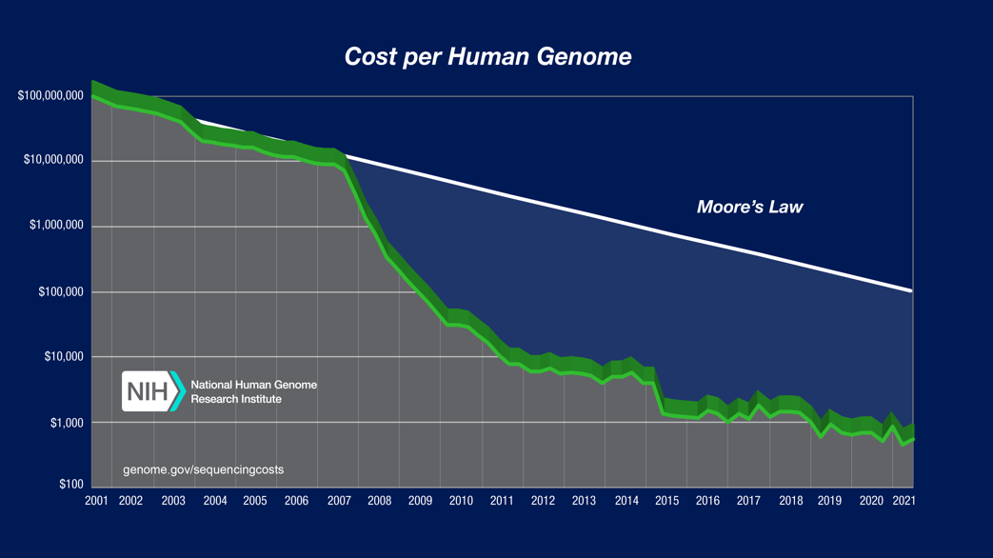
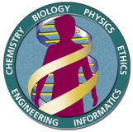
The era of big data
Notes:
HGP cost $2.7 billion took 13 years

Slide 14
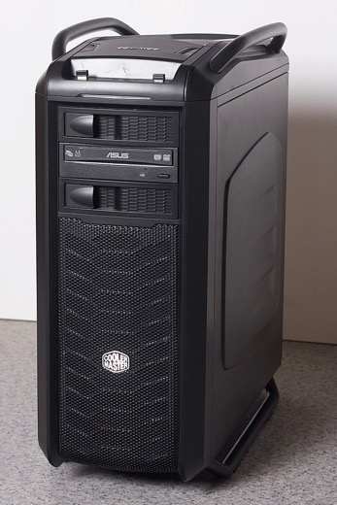
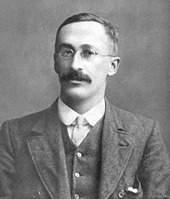

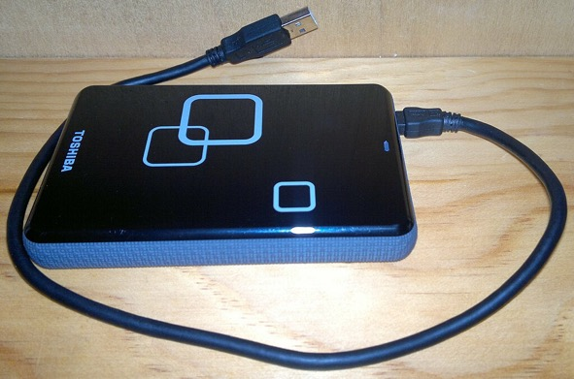
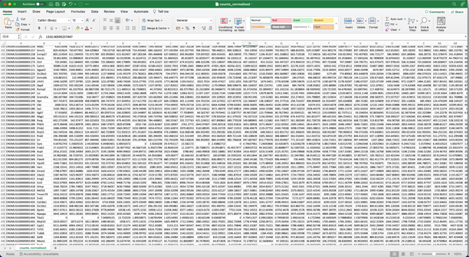
The era of big data
Notes:
Data Storage

Slide 15
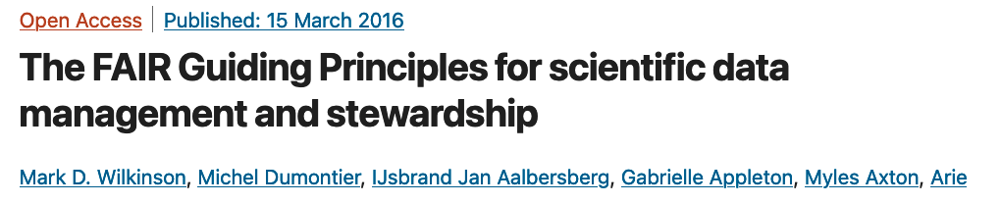

Data storage and Access
Verification of results presented in papers requires access to the data used to generate them
Data generated in one study can still be useful to other
Open Data rather than siloed inaccessible data
Findable Accessible Interoperable Reusable
Notes:
Reusable To achieve this, metadata and data should be well-described so that they can be replicated and/or combined in different settings.

Slide 16











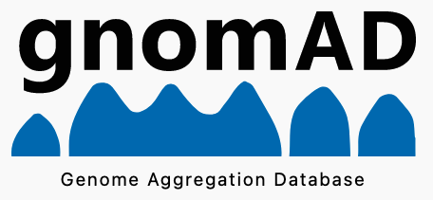
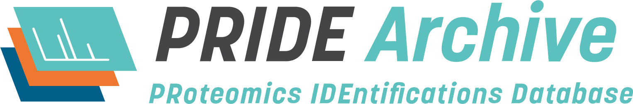

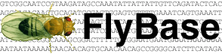

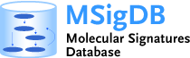







Data Repositories
Notes:
One of the hallmarks of modern genomic research is the generation of enormous amounts of raw sequence data.
As the volume of genomic data grows, sophisticated computational methodologies are required to manage the data deluge.
The very first challenge in the genomics era is to store and handle the staggering volume of information through the establishment and use of computer databases.
A biological database is a large, organized body of persistent data, usually associated with computerized software designed to update, query, and retrieve components of the data stored within the system.
A simple database might be a single file containing many records, each of which includes the same set of information.
The chief objective of the development of a database is to organize data in a set of structured records to enable easy retrieval of information.

Slide 17
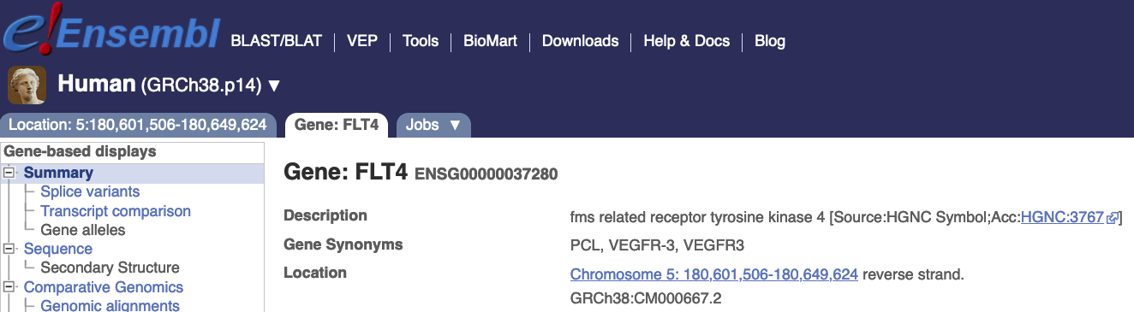
A word on gene names
Notes:
It's usually because of the way they were discovered, which can lead to all sorts of naming conventions. For example a gene discovered in Drosophila will usually be named after its phenotype, eg weird wing. The same gene will cause a completely different phenotype in yeast (they don't have wings!) so will be given a totally different name eg weird mitosis. The fly and yeast people will then go off and find the human orthologue and give it a related name, eg WW1 and WM1. Meanwhile, someone else will be doing some reverse genetics in human and be calling it something like locus1 or naming it after the contig on the genome where its found, eg RP11-I-found-it-here. Somebody else will find that it has some similarity to their favourite gene (TFG) so call it TFG-like or TFGL. Another person will discover it from studying a biological process, so call it biological process 1 (BP1).
Then HGNC will come along, whose mission is to provide unique and meaningful names for genes, and they will give it a definitive name, probably the name that tells you the most about its function, which in this case is BP1.
But that's not the end! The genome annotators then discover that it's not actually one gene, but two duplicated genes, so they each become BP1A and BP1B. All of those other names exist in the literature so both genes get all the synonyms WW1, WM1, Locus1, RP11-I-found-it-here, TFGL and BP1.

Slide 18
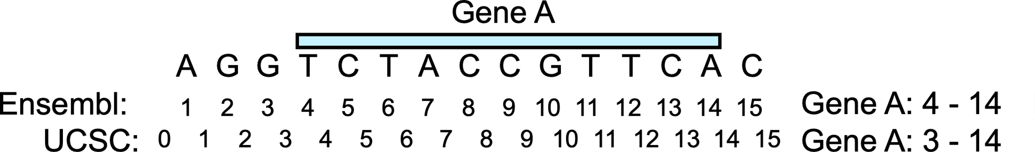
Genomic Sequence Data UCSC/NCBI versus Ensembl/Gencode/EBI
Ensembl uses a one-based coordinate system, whereas UCSC uses a zero-based coordinate system.
Ensembl/Gencode name sequences : 1, 2, 3 … 22, X, Y, MT
UCSC/NCBI name sequences: chr1, chr2, chr3 … chr22, chrY, chrX, chrM
Gene annotations differ significantly
Gene IDs are different and do not map 1:1

Slide 19
The era of big data
Notes:
Methods – Excel/Statistics Software e.g. SPSS

Slide 20
Programming languages in Bioinformatics
Bioinformatics creates huge quantities of data, and programming gives the means to analyse and interpret that data.
The two most popular languages are Python and R
Both are open source meaning they are freely available
Both have large communities of users and developers
Both have a wide range of bioinformatics resources and methods
Both are cross-platform
Others: Perl, Java, Ruby, Rust, Julia

Slide 21


R is a language and environment for statistical computing and graphics
R is available as Free Software under the terms of the Free Software Foundation’s GNU General Public License
RStudio provides a well developed integrated development environment (IDE) for R
The Comprehensive R Archive Network (CRAN) repository features 19877 available general usage packages
The Bioconductor project has 2230 bioinformatics specific packages

Slide 22

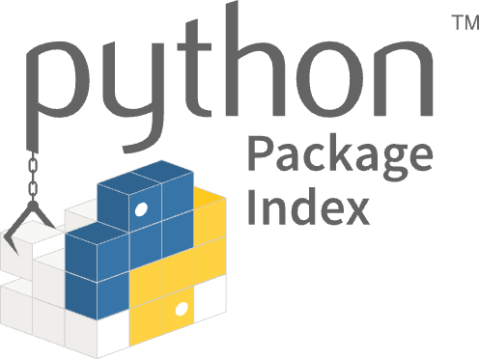

Python is a general-purpose, open-source programming language used in various software domains, including data science, web development, and gaming
Python is developed under an OSI-approved open source license, making it freely available
Various IDEs are available, e.g. Jupyter or Spyder
100,000s of packages available via the Python Package Index
Virtual environments easily managed with Conda
Python is more suitable for deep learning applications

Slide 23
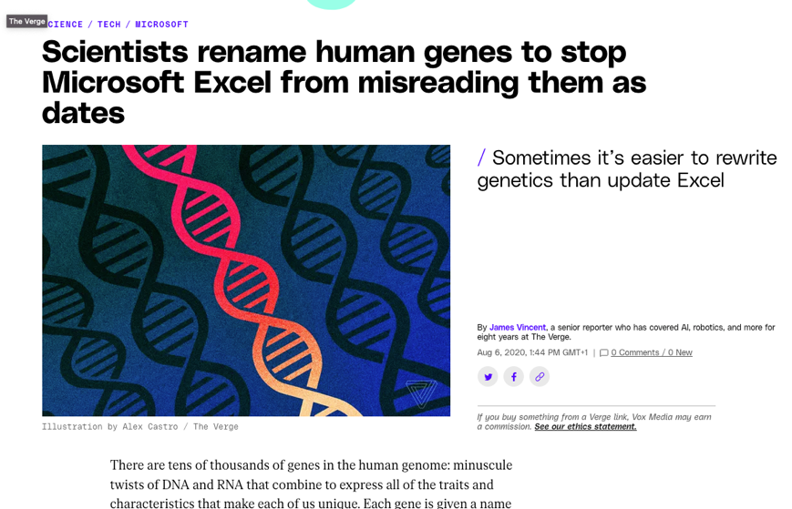
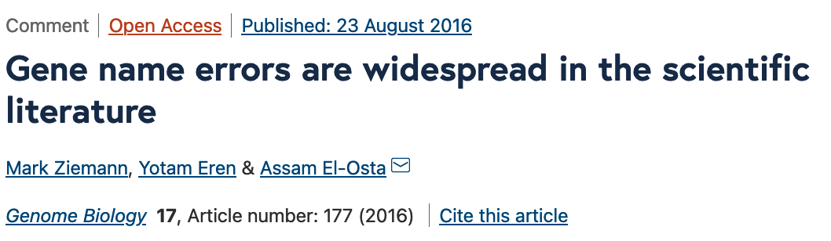
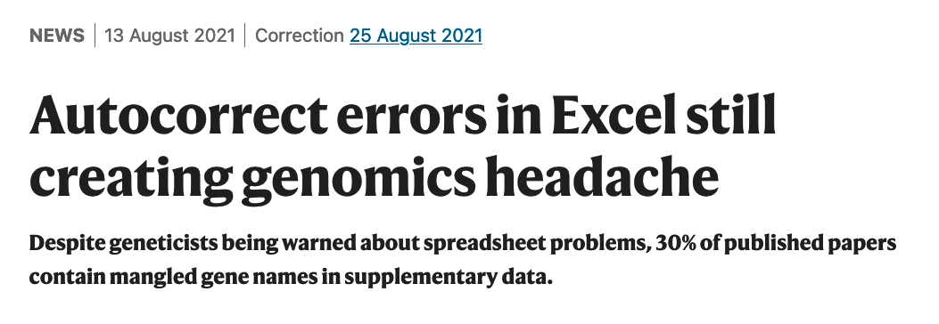
Excel tries to be helpful
MARCH1 → MARCHF1
SEPT1 → SEPTIN1

Slide 24
The era of big data
Notes:
Compute power

Slide 25
The need for more power
Massive data sets require a lot memory to store and process
Complex algorithms such as alignment need powerful processors to run in a reasonable time frame
Having a lot of processors available means that many jobs can be run in parallel
High-Performance Cluster – HPC (supercomputer)
Cloud solution – Google Cloud, Amazon Web Services (AWS), Microsoft Azure
Graphics Processing Units required for Deep Learning
Notes:
33 nodes.
Each with dual 20 core Broadwell Xeon CPUs (E5 2698v4)
320GB DDR4 RAM,
~1TB /tmp

Slide 26
The era of big data
Notes:
William Sealy Gosset who first published it in English in 1908 in the scientific journal Biometrika using the pseudonym "Student"[

Slide 27
Differing statistical approaches
Single/Few measures in a simple experimental design – t-test
More complex studies – Linear Model
Micro-arrays – Simple Linear Model with Normal Distribution
RNAseq data – Generalised Linear Model with Negative Binomial Distribution
10X Single Cell RNAseq – needs additional solutions to overcome missing data

Slide 28
Complex Data Requires New Solutions
Sequence alignment algorithms
Clustering algorithms
Hidden Markov Models (HMMs)
Phylogenetic tree construction algorithms
Molecular modelling algorithms
Variant/Mutation calling algorithms
Deep learning, large language models and machine learning
Notes:
BLAST (Basic Local Alignment Search Tool): This algorithm is used to search for similarities between DNA or protein sequences. It is widely used in bioinformatics to identify homologous sequences and to infer evolutionary relationships between species.
Clustering algorithms: These algorithms are used to group similar sequences or data points together based on their similarity. Some commonly used clustering algorithms in bioinformatics include k-means clustering, hierarchical clustering, and self-organizing maps.
Hidden Markov Models (HMMs): HMMs are statistical models that are used to represent and analyze sequences of observations. They are commonly used in bioinformatics to identify functional regions in proteins or to predict the secondary structure of RNA molecules.
Multiple sequence alignment algorithms: These algorithms are used to align multiple DNA or protein sequences to identify conserved regions of the sequence. Some commonly used multiple sequence alignment algorithms include ClustalW and MUSCLE.
Phylogenetic tree construction algorithms: These algorithms are used to construct evolutionary trees that represent the relationships between different organisms or sequences. Some commonly used phylogenetic tree construction algorithms include neighbor-joining, maximum likelihood, and Bayesian inference.
CTGCAGCCCCACGGCCAGCAGGTGCCCTACTACCTGGAGAACGAGCCCAGCGGCTACACGGTGCGCGAGGCCGGCCCGCCGGCATTCTACAGGCCAA

Slide 29
Overview
A Brief Overview of Bioinformatics
Bioinformatic Analysis of Next Generation Sequencing Data

Slide 30
Data literacy
The ability to not only carry out statistical analysis on real-world problems, but also to understand and critique any conclusions drawn by others on the basis of statistics.

Slide 31
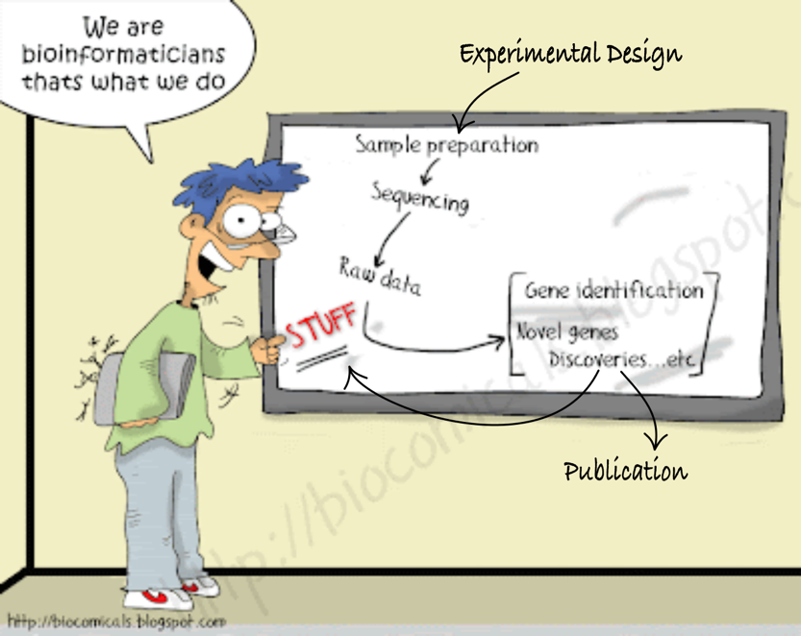
What we do…

Slide 32
The life of data – the PPDAC cycle
Understanding and defining the problem.
How do we go about answering this question?
Interpretation
Conclusions
Communication
Hypothesis generation
PROBLEM
PPDAC Cycle
CONCLUSION
PLAN
What to measure and how?
Study design ?
ANALYSIS
DATA
Data Cleaning
Statistical Analysis
Construct table, graphs
Look for patterns
Collection
Management

Slide 33
Consequences of Poor Experimental Design
Inability to answer the questions we would like to answer
Cost of experimentation.
Limited & Precious material, esp. clinical samples.
Immortalization of data sets in public databases and methods in the literature. Our bad science begets more bad science.
Ethical concerns of experimentation: animals and clinical samples.

Slide 34
A Well-Designed Experiment
Should have:
Clear objectives
Focus and simplicity
Sufficient power
Randomised comparisons
And be:
Precise
Unbiased
Amenable to statistical analysis
Reproducible

Slide 35
Sources of Variation
dependent variable = f ( independent variable ) + noise
Biological
Technical
Biological “noise”:
Biological processes are inherently stochastic
Single cells, cell populations, individuals, organs, species….
Timepoints, cell cycle, synchronized vs. unsynchronized
Technical noise:
Reagents, antibodies, temperatures, pollution
Platforms, runs, operators
Replication is required to capture variance
Randomisation overcomes technical variation

Slide 36
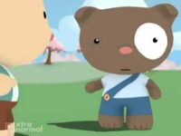
Talk to a statistician

Slide 37
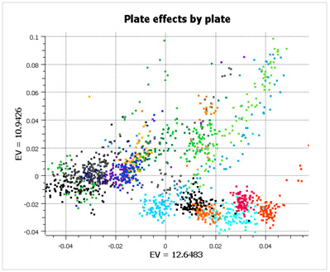
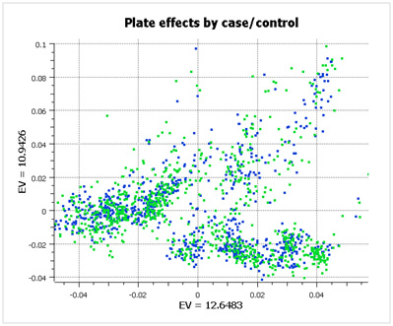
Randomisation
https://www.goldenhelix.com/blog/stop-ignoring-experimental-design-or-my-head-will-explode/

Slide 38
Next Generation Sequencing
We’ll focus on Illumina short read sequencing as this is the most commonly used method at the moment

Slide 39
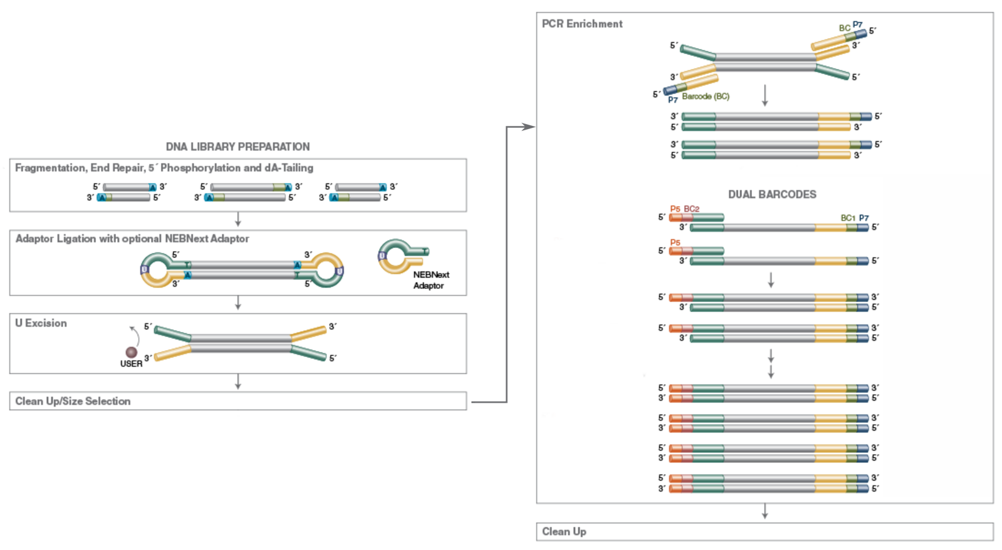
Next Generation Sequencing Library preparation

Slide 40
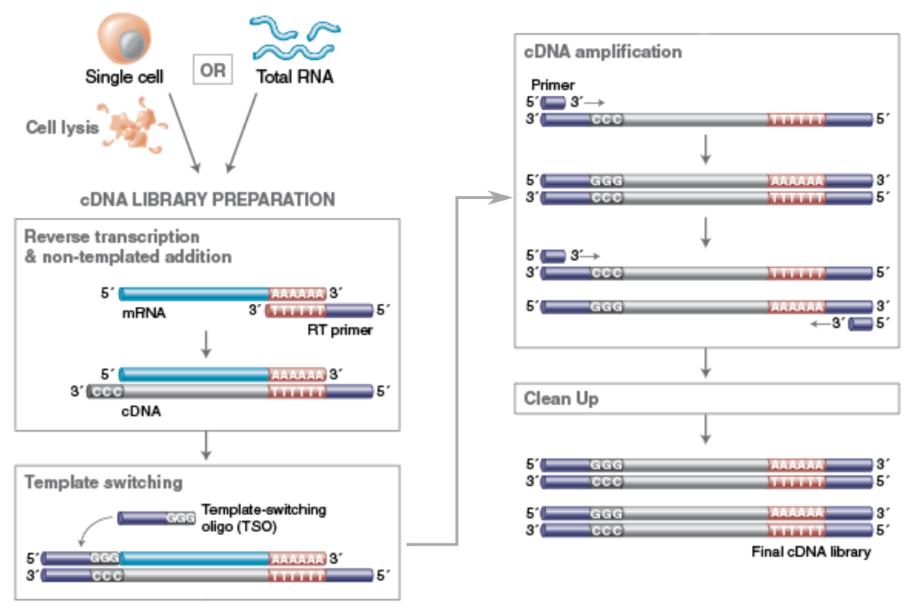
Next Generation Sequencing Library preparation

Slide 41
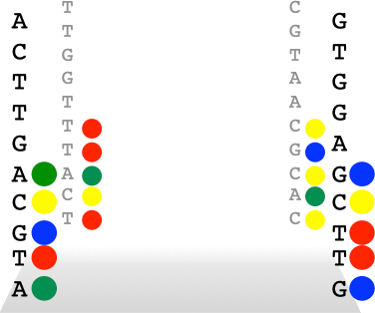
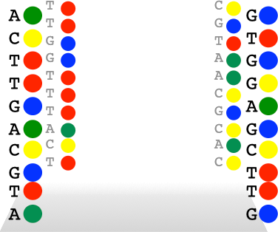
Next Generation Sequencing Sequencing by synthesis
A complimentary strand is synthesized using the cDNA fragment as template.
Each nucleotide includes a fluorescent tag and as the new strand is synthesized, the colour of the fluorescence indicates which base is being added.
The sequencer records the order of these flashes of light and translates them to a base sequence.

Slide 42
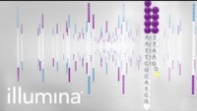
Next Generation Sequencing Sequencing by synthesis

Slide 43
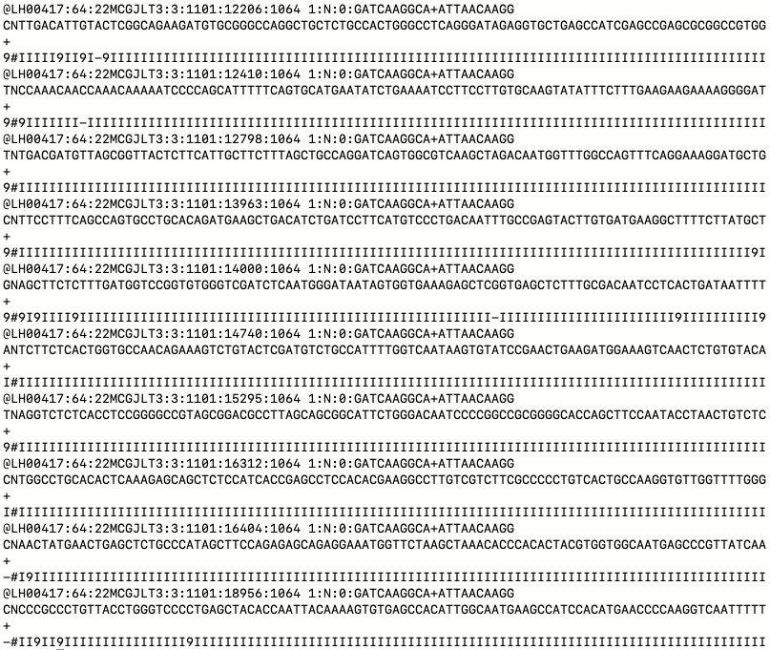
Fastq file format

Slide 44
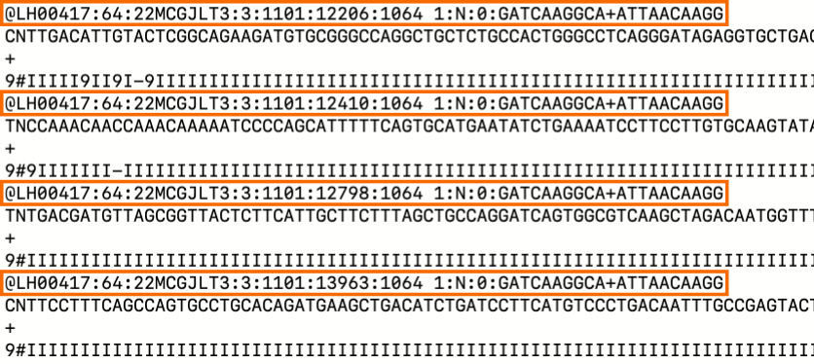
Fastq file format - Headers

Slide 45
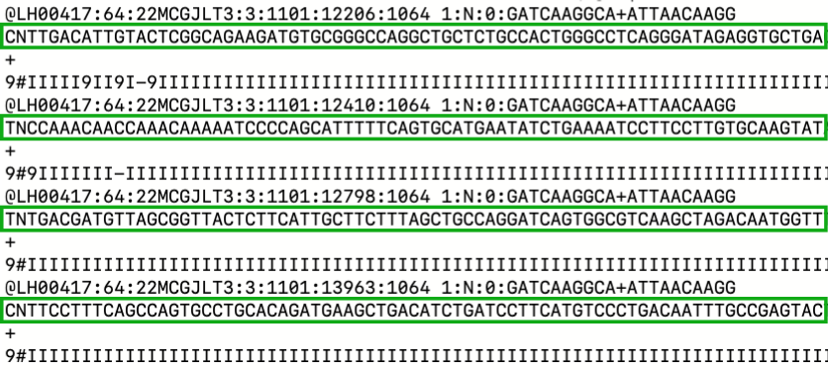
Fastq file format - Sequence

Slide 46
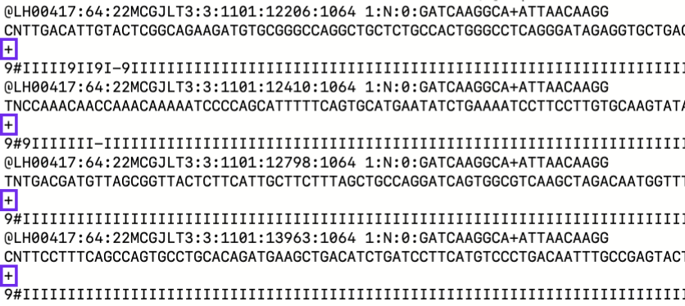
Fastq file format – Line 3

Slide 47
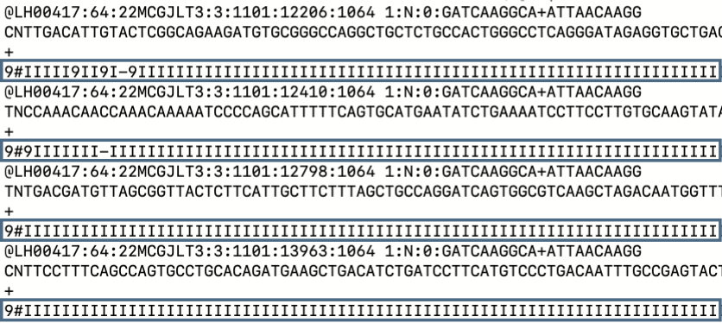
Fastq file format - Headers

Slide 48
(Phred) Quality Scores
Sequence quality scores are transformed and translated p-values
Sequence bases are called after image processing (base calling):
Each base in a sequence has a p-value associated with it
p-values range from 0-1 (e.g.: 0.05, 0.01, 1e-30)
p-value of 0.01 implies 1 in 100 chance that called base is wrong

Slide 49
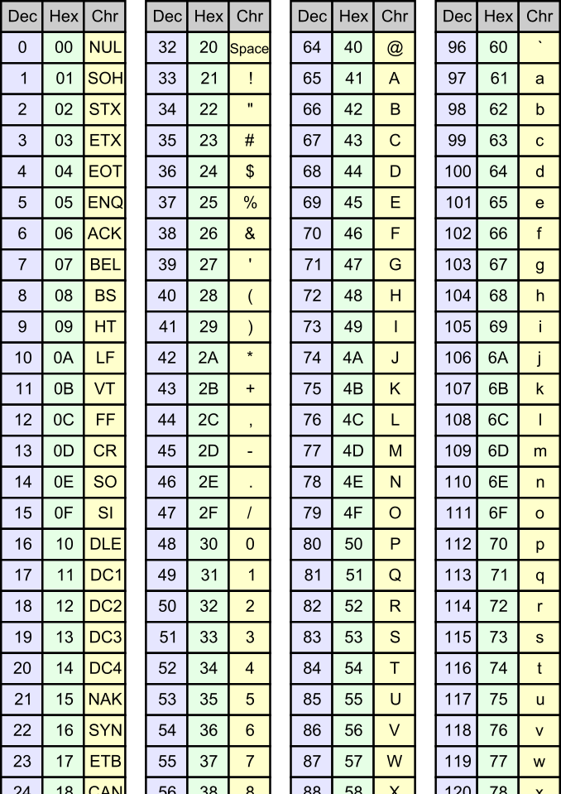
(Phred) Quality Scores …
How do we assign p-values to bases in the fastq file?
P-vales can be many characters long (e.g.:0.000005)
Transform to Phred quality scores - Q = −10 x log10(pvalue) :
If p = 0.01 → log10(0.01) = -2 → Q = 20
Translate Q values to ASCII characters (adding 33):
Q value of 2 = #, Q value of 40 = I
This gives us a single digit quality score code for each base that fits nicely in the fastq format

Slide 50

QC is important
Check for any problems before we put time and effort into analysing potentially bad data
Start with FastQC:
Quick
Outputs an easy-to-read html report
https://www.bioinformatics.babraham.ac.uk/projects/fastqc/

Slide 51
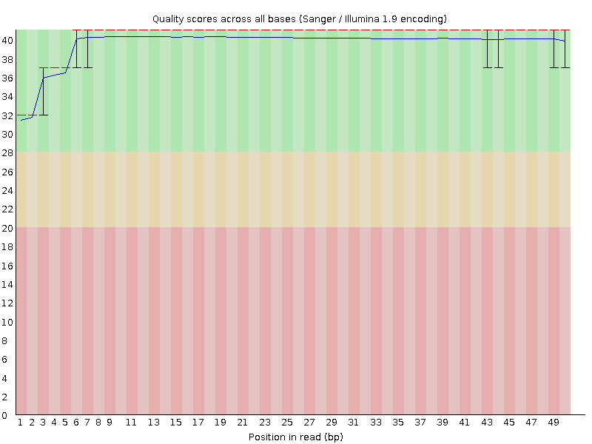
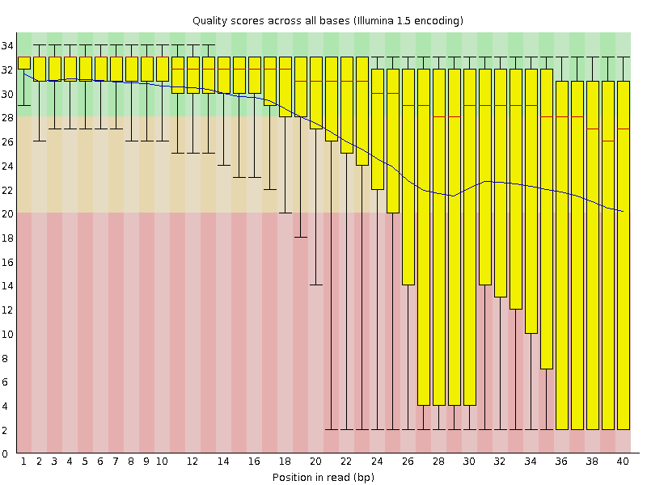
Per base sequence quality

Slide 52
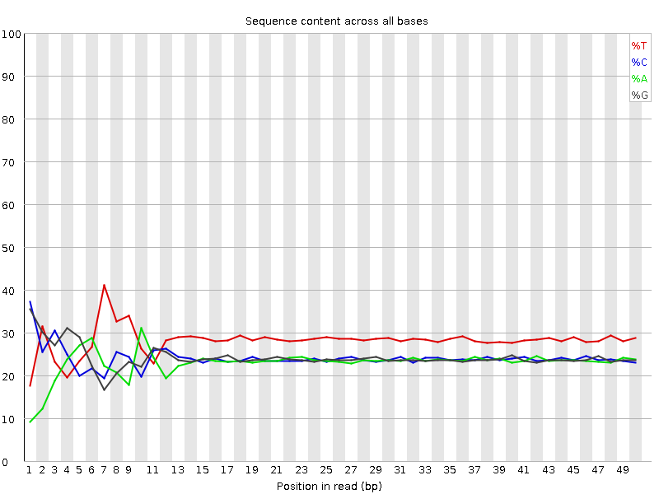
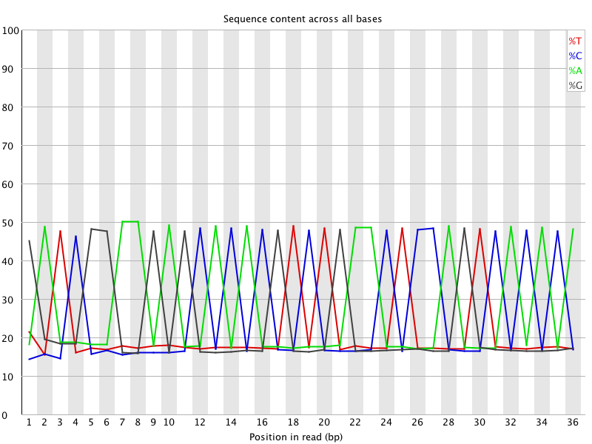
Per base sequence content

Slide 53
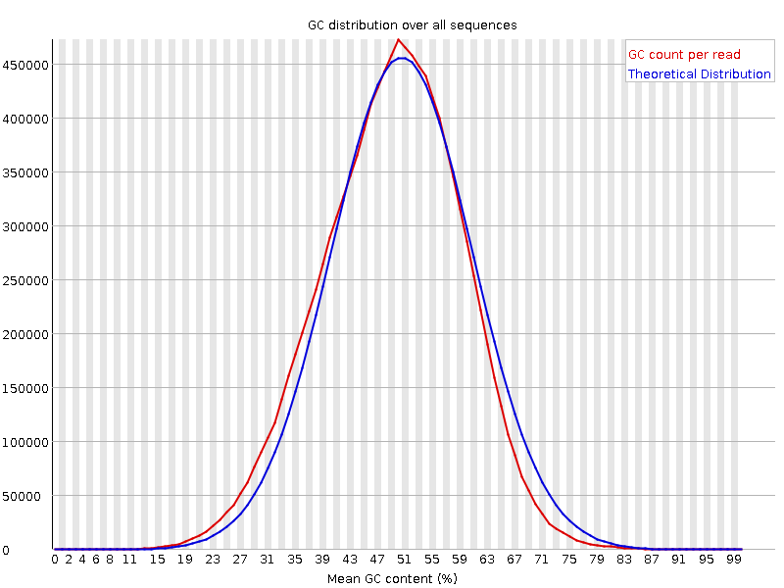
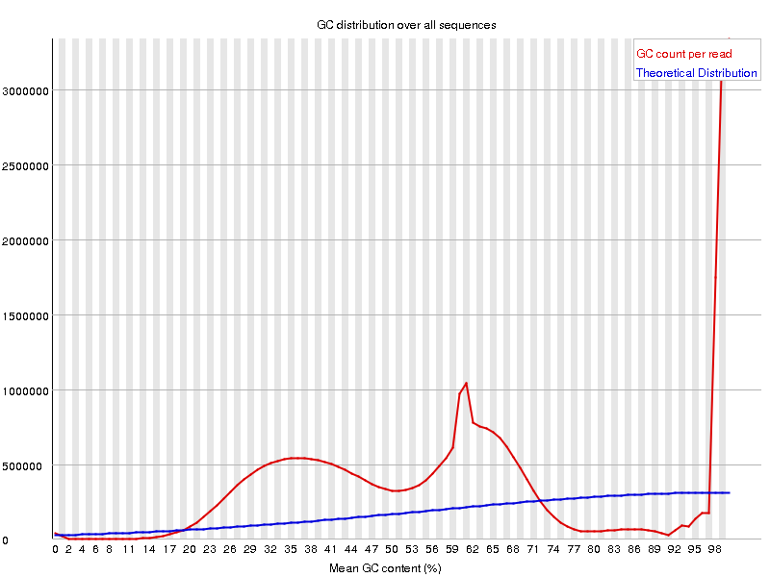
Per sequence GC content

Slide 54
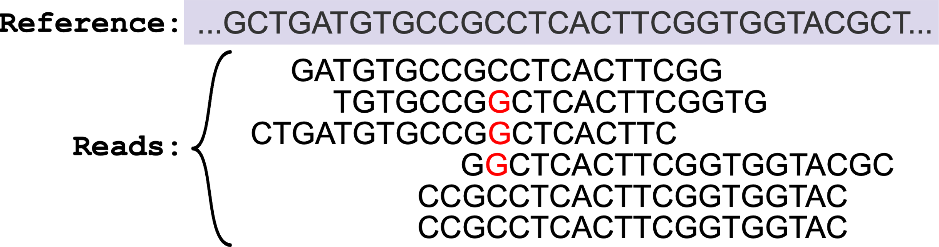
Read Alignment
AIM: Given a reference sequence and a set of short reads, align each read to the reference sequence finding the most likely origin of the read sequence.

Slide 55
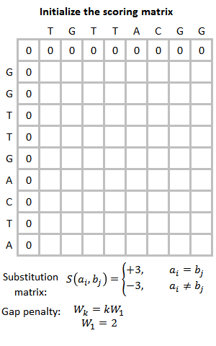
Read Alignment
1970 – Needleman-Wunsch algorithm for sequence alignment published
The Smith-Waterman algorithm was the first alignment algorithm to include the concept of gaps
Faster less computationally intensive alignment algorithms have been developed
Aligners also use indexes of the genome to speed up alignment

Slide 56
Short Read Aligners
There are a lot of short read aligners, which use a variety of indexing algorithms and alignment algorithms.
The most popular are probably:
The Burrows-Wheeler Aligner (BWA) - https://github.com/lh3/bwa
Bowtie2 - https://github.com/BenLangmead/bowtie2
STAR - https://github.com/alexdobin/STAR
HISAT2 - http://daehwankimlab.github.io/hisat2/

Slide 57
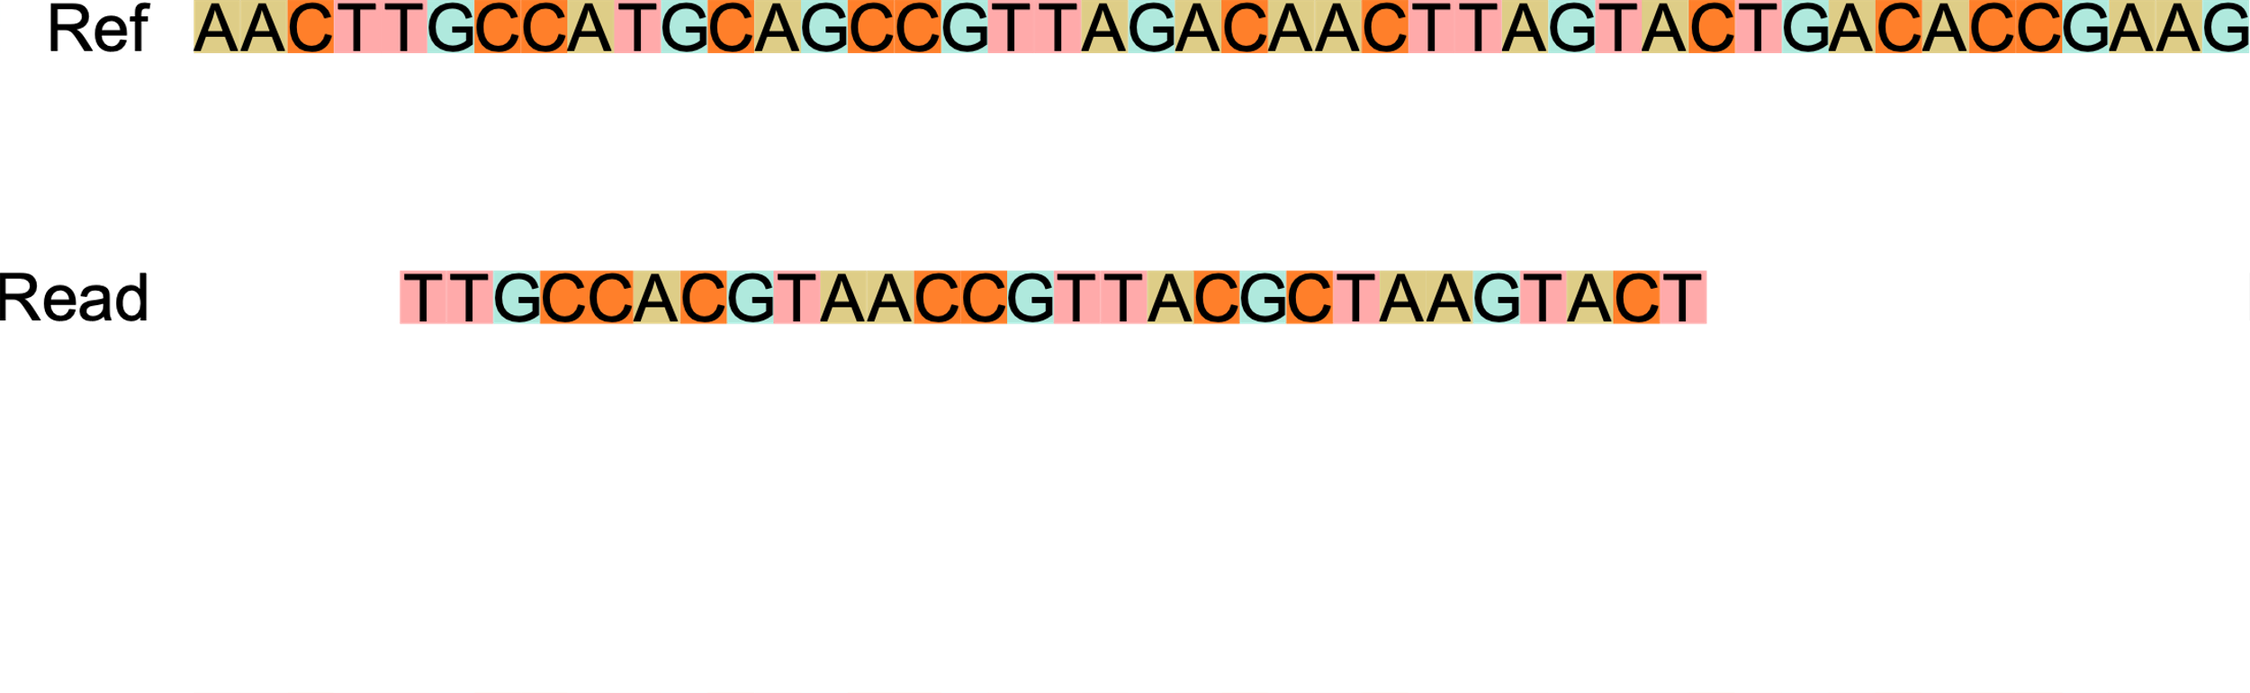
Alignment

Slide 58
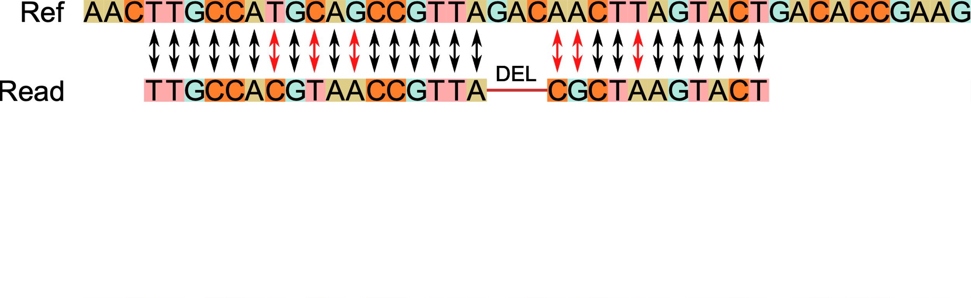
Alignment

Slide 59

mRNAseq Alignment

Slide 60
Short Read Aligners
There are a lot of short read aligners, which use a variety of indexing algorithms and alignment algorithms.
The most popular are probably:
The Burrows-Wheeler Aligner (BWA) - DNA
Bowtie2 - DNA
STAR - Either
HISAT2 - Either

Slide 61
SAM format
Sequence Alignment/Map (SAM) format is the standard format for files containing aligned reads.
Two main parts:
Header - meta data (source of the reads, reference genome, aligner, etc.)
Alignment section:
1 line for each alignment
contains details of alignment position, mapping, base quality etc.
11 required fields, but other content may vary depending on aligner and other tools used to create the file

Slide 62

SAM format

Slide 63

SAM format

Slide 64

SAM format

Slide 65

SAM format

Slide 66

SAM format

Slide 67

SAM format

Slide 68
DNAseq – Somatic Variant Calling
AIM: To identify mutations in the genome
Whole Genome Sequencing, Whole Exome Sequencing, Targeted Panels
Sequence paired end with long(ish) reads (>=150 bp)
Remove or mark duplicate reads
Align to genome including viral decoy sequences, e.g. human cytomegalovirus (CMV), Epstein-Barr virus (EBV)
Call Single Nucleotide Variants (SNV) and small Insertions/Deletions (Indels)
Many somatic mutations may have very low variant allele frequency - sequence to high depth – 100x coverage
Differentiate germline variants by including both a tumour sample and a normal sample

Slide 69

DNAseq – Somatic Variant Calling

Slide 70

DNAseq – Somatic Variant Calling

Slide 71




DNAseq – Somatic Variant Calling

Slide 72
Several factors complicate somatic SNV calling
Low cellularity (tumour DNA content)
Intra-tumour heterogeneity in which multiple tumour cell populations (subclones) exist
Aneuploidy
Unbalanced structural variation (deletions, duplications, etc.)
Matched normal contaminated with cancer DNA
adjacent normal tissue may contain residual disease or early tumour-initiating somatic mutations
circulating tumour DNA in blood normals
Sequencing errors
Alignment artefacts
Mwenifumbo & Marra, Nat Rev Genet. 2013

Slide 73
DNAseq – Somatic Variant Calling
There are a lot of tools for somatic variant calling.
Some of the most popular are:
Mutect2 (GATK)
Strelka
FreeBayes
VarDict
VarScan2
They take different approaches, and it is not uncommon to use multiple tools to call variants and then take a consensus

Slide 74

Using Mutect2 from GATK
References required:
Genome Reference – same as used to align
Germline Resource – e.g. Gnomad
If not WGS then intervals list

Slide 75

Variant Call Format (VCF) output

Slide 76

Hypermutation Signatures in Glioblastoma

Slide 77

Single Cell RNAseq
Average expression level
Comparative transcriptomics
Disease biomarker
Homogenous systems
Separate populations
Define heterogeneity
Identify rare cell populations
Cell population dynamics

Slide 78




Single Cell RNAseq

Slide 79

Single Cell RNAseq
Source: Svensson et al. Nat Protoc 13, 599–604 (2018)

Slide 80

scRNAseq analysis workflow

Slide 81

Trajectory Analysis

Slide 82
scRNAseq analysis workflow

Slide 83

Cluster Marker Genes

Slide 84
scRNAseq analysis tools
Alignment, Gene Expression Quantification, Cell Calling, QC:
CellRanger (10X), STARsolo, Alevin
Data Exploration:
Loupe Browser (10X)
Downstream Analysis:
R – Bioconductor packages: scran, scater, bluster, MiloR, SingleR
See the OSCA book at https://bioconductor.org/books/release/OSCA/
R – Seurat
See the Seurat documentation at https://satijalab.org/seurat/
Python – Scanpy
See the Scanpy documentation at https://scanpy.readthedocs.io/en/stable/

Slide 85
What is Bioinformatics?
In the beginning of the 1970s, Ben Hesper and I started to use the term “bioinformatics” for the research we wanted to do, defining it as “the study of informatic processes in biotic systems”.
Paulien Hogeweg, https://doi.org/10.1371/journal.pcbi.1002021

Slide 86
Thank You

